Slide 1
Interoperable Social Determinants of Health: LOINCing the PCAM
Sharon Hewner, PhD RN
PCAM/LOINC
| Hewner presentation| 08.25.2016

Slide 2
Coordinating Transitions Intervention
Care transition alerts provided real-time notification of discharges for high risk patients (based on risk stratification) and telephone outreach by the nurse care coordinator which included social determinants of health assessment, and sharing results across settings using interoperable HIE.
RN Outreach
Interoperable HIE
Risk Stratification
Used automated discharge notification from the hospital
Compared against cohort table created to identify those with chronic disease
Included relative risk of hospitalization to allow prioritization of outreach
Care Coordinator made telephone call to individual or caregiver with 3 days of discharge
Typical transitional care activities
assessment of social determinants of health using PCAM
RHIO delivered health information to healthcare providers across settings
Results of the call were included in transitions of care note
Interoperable continuity of care document (CCD) is available across healthcare settings
PCAM/LOINC
| Hewner presentation| 08.25.2016

Slide 3
However, the combination of HIE and SDH assessment changed practice dramatically
ADT Notification
Care Coordinator in HeL
ED discharges
Care Transition Alerts
Other Inpatient discharges
Triage nurse schedules follow-up
provider nurse obtains reports and results
Care coordinator call placed
PCAM completed
Medication reconciliation
Follow-up scheduled
Triage nurse makes clinical call and schedules follow-up
Provider nurse obtains reports and results
PCAM/LOINC
| Hewner presentation| 08.25.2016

Slide 4
Outcomes of Coordinating Transitions Project
We calculated expected IP, ED, and OP events based on 2014 rates per 1,000 Medicaid adults with chronic disease (N=1,039). Avoided IP and ED events were the differences between 2015 expected events and actual events. Regional mean allowed amounts for 2009 were used to estimate savings.
Estimated cost-reduction (expected – actual)
IP rate/1,000
ED rate/1,000
OP rate/1,000
Expected = 294
Actual = 230
Avoided admissions = 67
Expected = 3,182
Actual = 2,004
Avoided emergency department visits = 1,224
Expected = 6,695
Actual = 7,760
Additional office visits = 807
$1,633,428 total for adult Medicaid patients with chronic disease
$1,572 per person (compared to $672 for closest control practice)
PCAM/LOINC
| Hewner presentation| 08.25.2016

Slide 5
Patient Centered Assessment Method (PCAM)
Tool developed for use in primary care by Department of Family Medicine and Community Health at the University of Minnesota
www.pcamonline.org
© Maxwell, Hibberd, Pratt, Peek and Baird 2013. PCAM may not be copied or shared with any third party without inclusion of this copyright declaration. There are no license costs for the use of PCAM and the developers are committed to PCAM being freely available to use.
PCAM/LOINC
| Hewner presentation| 08.25.2016
| Hewner presentation| 08.25.2016

Slide 6
Implementing PCAM in HIE
After completing the telephone outreach the nurse care coordinator in the primary care practice completed paper version of PCAM and then entered the results into a laboratory report within the Allscripts EHR that was ordered as part of the outreach call.
No clear scoring
Limited problem identification
Data, but without knowledge
Limited text characters
50 characters for question
20 characters for responses
The lengthy responses often contained two separate concepts, so we split into sub-items to stay within the character limitations
Within the laboratory report there was no way to calculate a total score
Usability test on prototype ePCAM
Explored ways to increase the understanding of results through development of scores and data visualization
The ePCAM gave the complete text of question and response
A total score and total by domain was calculated and we used spider diagrams and histograms to display results
Responses to questions over 3 were considered areas that needed to be addressed in care plan
When the lab results were shared in HIE using CDA the responses showed up as a placeholder value
Discrete values were lost
Text of the problems identified were copied and pasted from the ePCAM into the care coordinators transition of care note
PCAM/LOINC
| Hewner presentation| 08.25.2016

Slide 7
Results of PCAM
Disappointing completion rate (29% of 258 cases with care transition alert)
Normal distribution of total PCAM score
Significant correlation between all domains except social environment and health literacy/communication (n=46)
PCAM/LOINC
| Hewner presentation| 08.25.2016

Slide 8
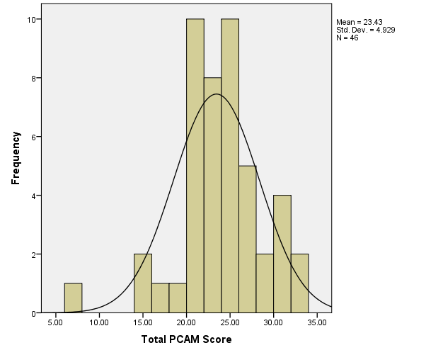
Histogram of Total PCAM Scores

Slide 9
Correlation Between PCAM Domain Scores (n=46)
ePCAM Domain | Health & Well-being | Social Environment | Health Literacy & Communication
Social Environment | .765**
Health Literacy & Communication | 0.359* | 0.197
Service Coordination | 0.449* | 0.379** | 0.313*
Note: p<0.05* p<0.01**

Slide 10
ePCAM demonstration
Link to new version
Based on usability testing, real world implementation, and in collaboration and with approval of PCAM developers

Slide 11
Next steps
Create LOINC codes for each question and for the scores
Plan to develop way to move ePCAM discrete values from web-based tool to the EHR
Eventually plan to define problems identified using SNOMED-CT and possibly ICD-10 codes
PCAM/LOINC
| Hewner presentation| 08.25.2016

